Slide 1




CAREER COUNSELING SYSTEM
Project Presentation
BACHELOR OF TECHNOLOGY
In
COMPUTER SCIENCE & ENGINEERING
Guide Name
Mr. Dipayan Kumar Ghosh
Asst. Professor , CSE Dept , MITRC
Presented By
Tarun Yadav
Sahil Soni
Tushar Yadav
Aditya Kumar
Chandra Prakash
Bikaner Technical University, Bikaner
Modern Institute of Technology & Research Centre,
Alwar

Slide 2
ABSTRACT
Careerly is a dynamic career counseling web application designed to guide users in identifying ideal career paths through personalized skill assessments. Built with HTML, CSS, JavaScript, and Bootstrap for a responsive frontend and Django for backend logic, the app leverages SQLite for database management. The system employs the KNN machine learning algorithm to analyze user-rated skills (on a 0-5 scale) and generate tailored career recommendations. Users can authenticate securely, explore detailed career profiles with required skills, and access actionable insights. An admin panel allows administrators to manage users, careers, and assessment criteria, ensuring scalable content updates. Careerly bridges skill evaluation with career discovery, offering an intuitive platform for both career seekers and administrators.

Slide 3
PROBLEM STATEMENT
Many individuals struggle to identify suitable career paths due to unclear alignment between their skills and industry demands. Traditional career guidance lacks personalization, dynamic skill-based recommendations, and efficient management of evolving career data. Careerly addresses these gaps by offering a data-driven platform that automates skill-to-career mapping using machine learning (KNN), empowers users with actionable insights, and equips administrators with tools to update career trends seamlessly.

Slide 4
INTRODUCTION & PROJECT DESCRIPTION
Careerly is an intelligent career counseling web application designed to guide students towards suitable career options. By collecting inputs such as stream (science, commerce, arts), skills, interests, and preferences, the system uses the K-Nearest Neighbors (KNN) algorithm to predict ideal career matches.
1. Purpose
2. Target Audience
To create an accessible and user-friendly tool to guide students towards suitable career options.
Students who struggle with identifying right career path due to lack of proper guidance.

Slide 5
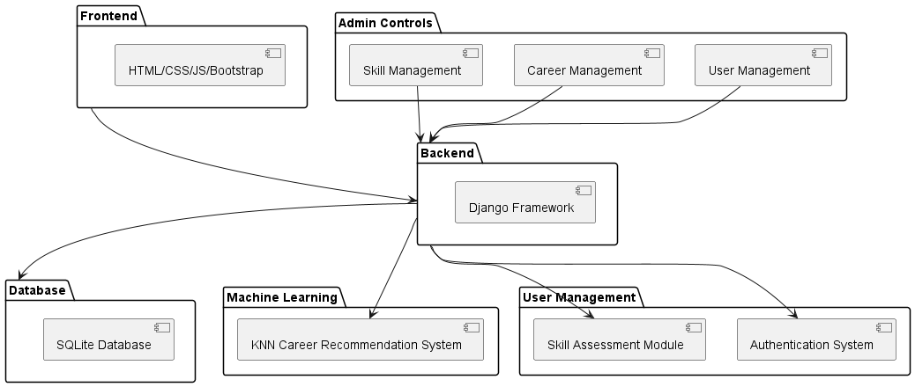
COMPONENT DIAGRAM

Slide 6
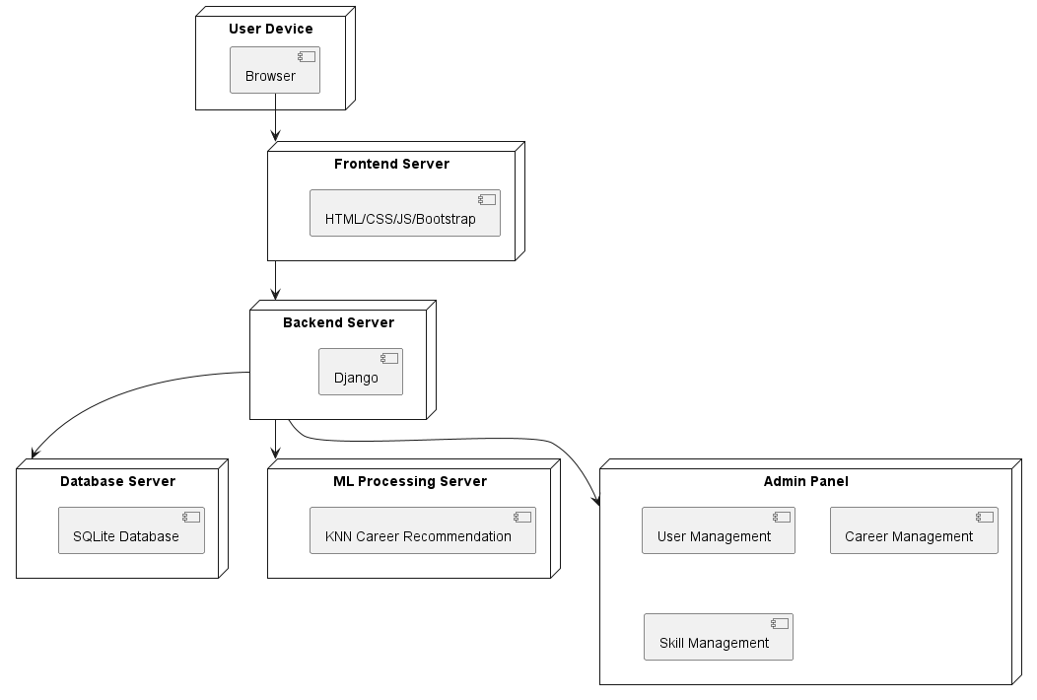
DEPLOYMENT DIAGRAM

Slide 7
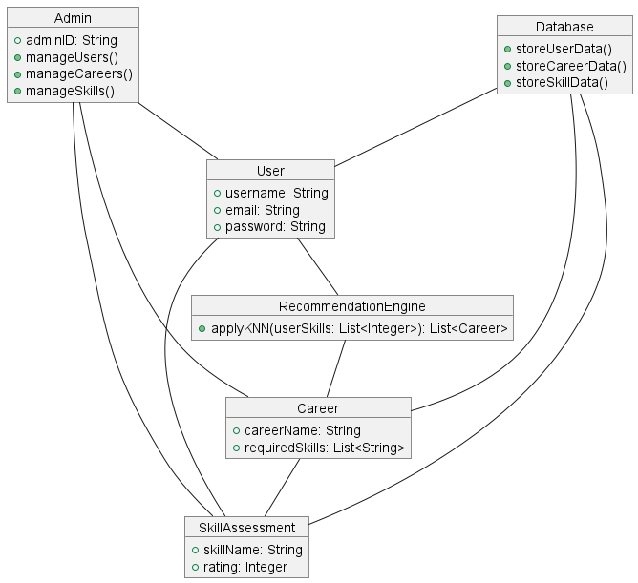
OBJECT DIAGRAM

Slide 8
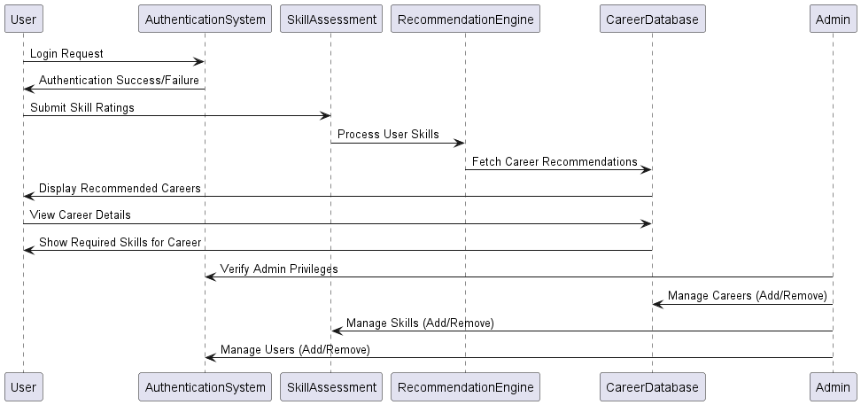
COMMUNICATION DIAGRAM

Slide 9
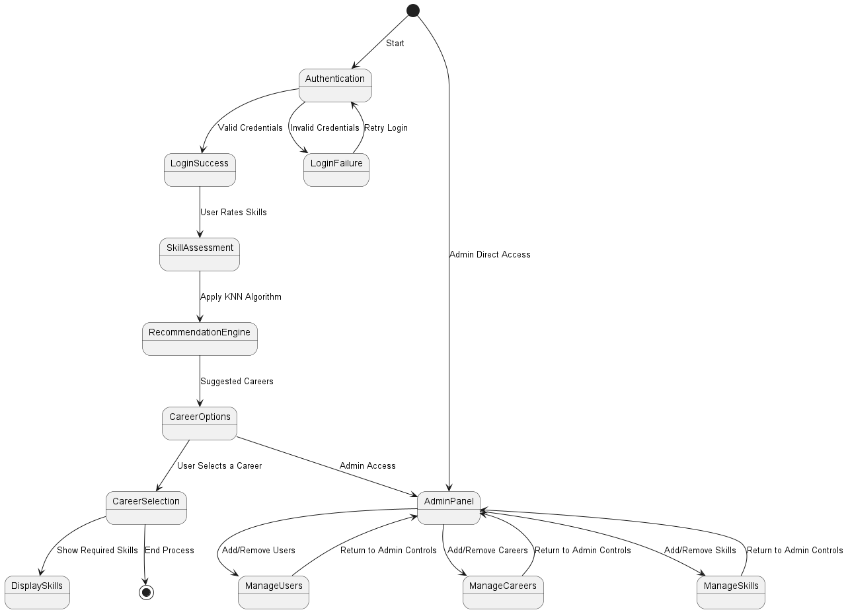
STATE DIAGRAM

Slide 10
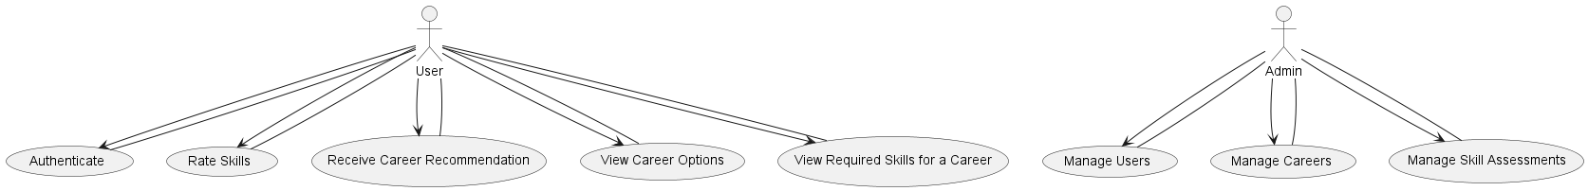
USE CASE DIAGRAM

Slide 11
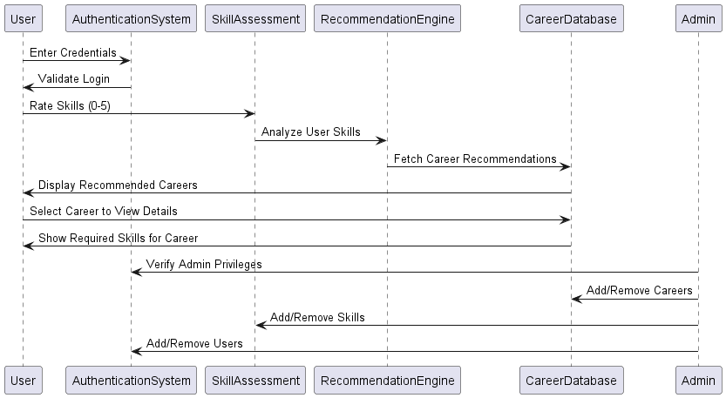
SEQUENCE DIAGRAM

Slide 12
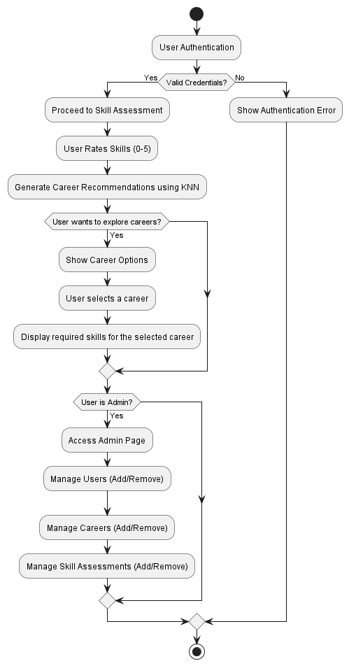
ACTIVITY DIAGRAM

Slide 13
Technology Used
Frontend:
HTML
CSS
JavaScript
Bootstrap
Backend:
Django (Python Framework)
SQLite (C Library)
Machine Learning:
KNN Algorithm (For career prediction)
Software Requirements:
Python
Django
MySQL Server
VS Code / PyCharm
Web Browser

Slide 14
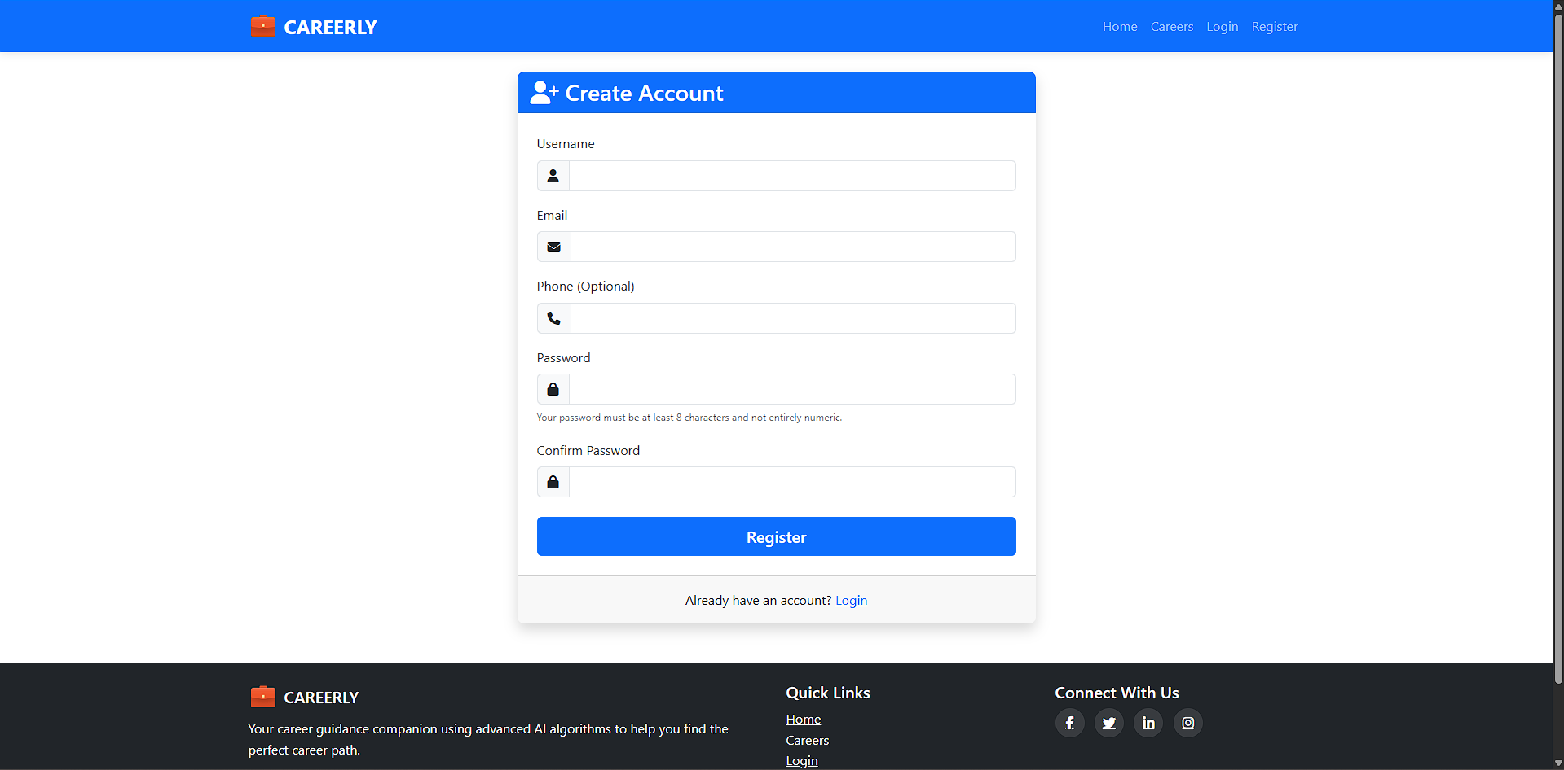
User Authentication

Slide 15
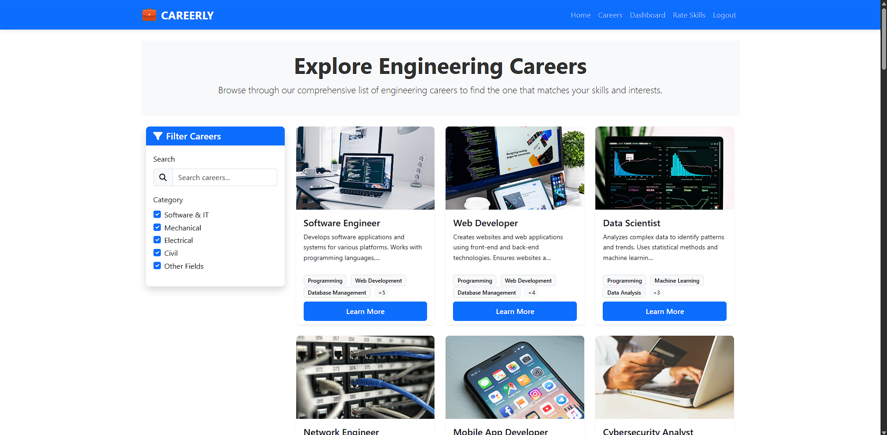
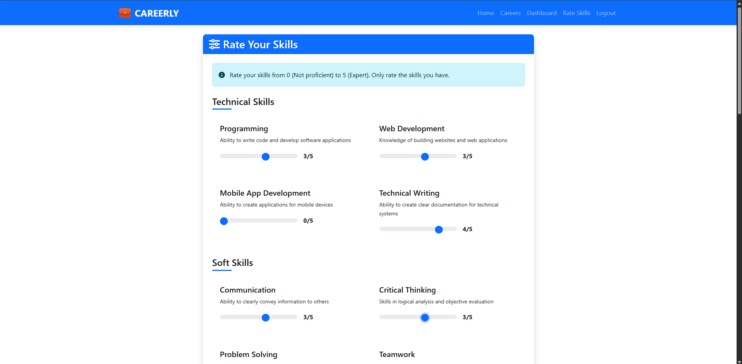
Careers and Skill Assessment

Slide 16
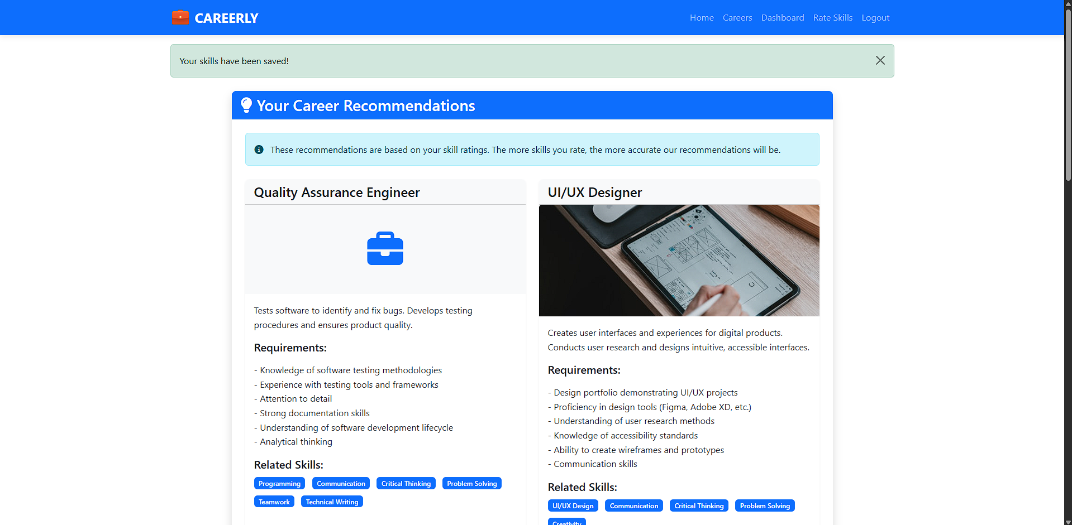
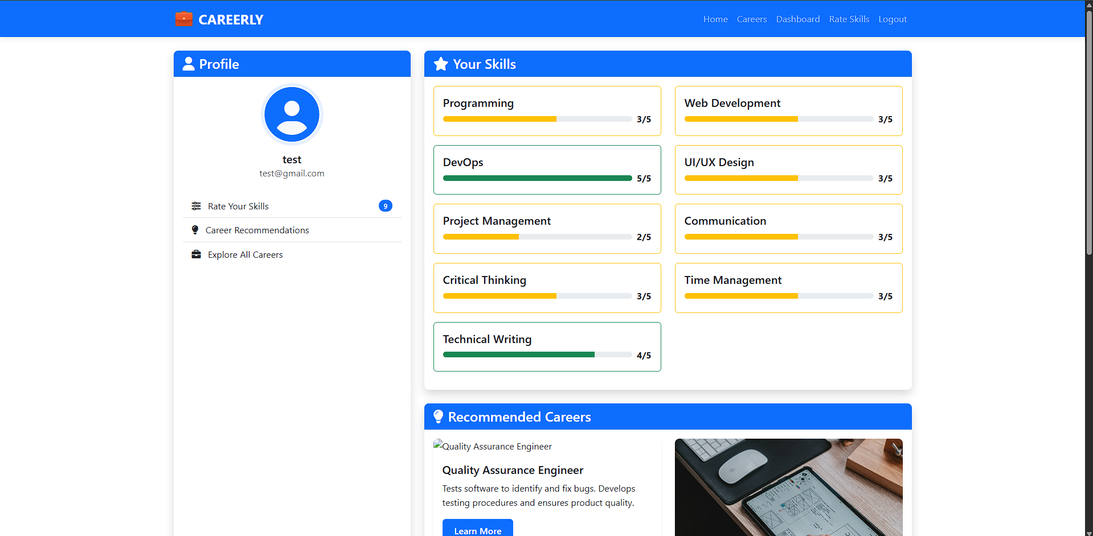
Career Recommendations & Dashboard

Slide 17
CONCLUSION
Careerly bridges the gap between self-assessment and career discovery by automating skill-to-career recommendations using the KNN algorithm.
It combines user-friendly interfaces (HTML, CSS, Bootstrap) with a robust backend (Django) for scalable, secure, and dynamic career guidance.
Users gain data-driven career insights by rating skills (0-5), with tailored recommendations highlighting required competencies.
The admin panel simplifies managing users, careers, and skill criteria, ensuring adaptability to evolving industry needs.
Future enhancements include integrating advanced ML models, expanding career databases, and adding mentorship/networking features.
Careerly offers a modern, practical solution to replace outdated, impersonal career counseling methods.

Slide 18
FUTURE WORK
Roadmap Integration
Develop a visual career roadmap to guide users on skill development timelines, certifications, and milestones for chosen careers.
AI-Powered Career Insights
Integrate DeepSeek, ChatGPT, or Gemini APIs for advanced NLP-based career counseling, resume reviews, and interview preparation.
Enable real-time career trend analysis using AI to suggest emerging roles and industry demands.
Enhanced Skill-Career Matching
Combine KNN with deep learning models (e.g., neural networks) for more nuanced skill-to-career alignment.
Personalized Learning Paths
Collaborate with e-learning platforms (Coursera, Udemy) to recommend courses based on skill gaps and career goals.
Dynamic Industry Data Sync
Automatically update career databases using APIs (LinkedIn, Glassdoor) to reflect real-time salary trends, job openings, and skill requirements.

Slide 19
References
https://openai.com/ – ChatGpt
https://scikit-learn.org/ – KNN Implementation
Django Documentation – https://docs.djangoproject.com/
MySQL Docs – https://dev.mysql.com/doc/
W3Schools, GeeksforGeeks – For frontend and backend tutorials
https://youtube.com/
https://cursor.com/ - AI Code Editor
https://deepseek.com/

Slide 20
Thank You

